Slide 1
Chapter 17: Protection

Slide 2
Outline
Goals of Protection
Principles of Protection
Protection Rings
Domain of Protection
Access Matrix
Implementation of Access Matrix
Revocation of Access Rights
Role-based Access Control
Mandatory Access Control (MAC)
Capability-Based Systems
Other Protection Implementation Methods
Language-based Protection

Slide 3
Objectives
Discuss the goals and principles of protection in a modern computer system
Explain how protection domains combined with an access matrix are used to specify the resources a process may access
Examine capability and language-based protection systems
Describe how protection mechanisms can mitigate system attacks

Slide 4
The Protection Problem
A computer system consists of a collection of objects:
Hardware
Software
Each object has a unique name and can be accessed through a well-defined set of operations
Goal - ensure that each object is accessed correctly and only by those processes that are allowed to do so

Slide 5
The Security Problem
System is secure if resources used and accessed as intended under all circumstances
Unachievable
Intruders (crackers) attempt to breach security
Threat is potential security violation
Attack is attempt to breach security
Attack can be accidental or malicious
Easier to protect against accidental than malicious misuse

Slide 6
The Security/Protection Problem
Both protection and security are vital to computer systems. We distinguish between these two concepts in the following way:
Security is a measure of confidence that the integrity of a system and its data will be preserved.
Protection is the set of mechanisms that control the access of processes and users to the resources defined by a computer system. We focus on protection in this chapter and address security in chapter 16.

Slide 7
Goals of Protection
A computer system consists of a collection of objects, hardware or software
Each object has a unique name and can be accessed through a well-defined set of operations
Protection problem - ensure that each object is accessed correctly and only by those processes that are allowed to do so

Slide 8
Principles of least privilege
Programs, users and systems should be given just enough privileges to perform their tasks
Limits damage if entity has a bug, gets abused
Can be static (during life of system, during life of process)
Or dynamic (changed by process as needed) – domain switching, privilege escalation
“Need to know” a similar concept regarding access to data

Slide 9
Principles of Protection
Must consider “grain” aspect
Rough-grained privilege management easier, simpler, but least privilege now done in large chunks
For example, traditional Unix processes either have abilities of the associated user, or of root
Fine-grained management more complex, more overhead, but more protective
Access Control List (ACL) lists,
Role Based Access Control (RBAC)
Domain can be user, process, procedure

Slide 10
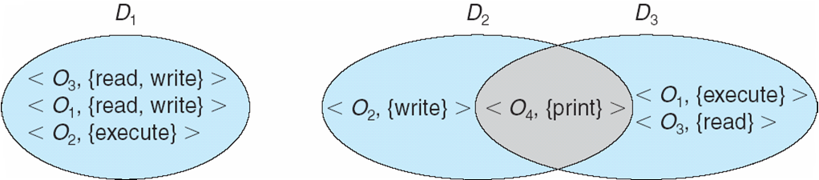
Domain Structure
Access-right = <object-name, rights-set>
rights-set is a subset of all valid operations that can be performed on the object
Domain = set of access-rights
Domains can overlap
Example
Domain implementation:
UNIX
Multics

Slide 11
UXIX Domain Implementation
Domain = user-id
Domain switch accomplished via file system
Each file has associated with it a domain bit (setuid bit)
When file is executed and setuid = on, then user-id is set to owner of the file being executed
When execution completes user-id is reset
Domain switch accomplished via passwords
su command temporarily switches to another user’s domain when other domain’s password provided
Domain switching via commands
sudo command prefix executes specified command in another domain (if original domain has privilege or password given)

Slide 12
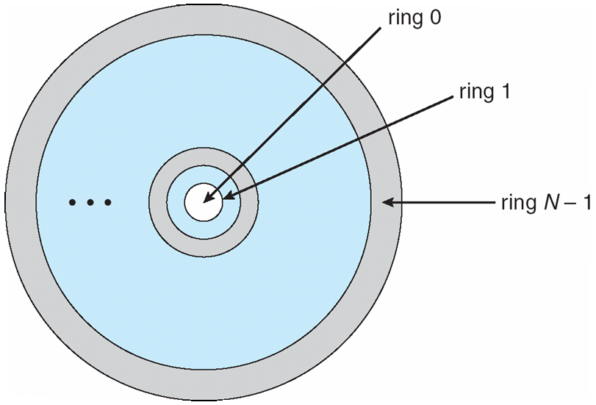
Multics Domain Implementation
Let D_{i} and D_{j} be any two domain rings
If j < I ⇒ D_{i} ⊆ D_{j}
Illustration

Slide 13
Multics Benefits and Limits
Ring / hierarchical structure provided more than the basic design:
kernel / user or
root / normal user
Fairly complex ➔ more overhead
But does not allow strict need-to-know
Object accessible in D_{j} but not in D_{i}, then j must be < i
But then every object accessible in D_{i} also accessible in D_{j}

Slide 14
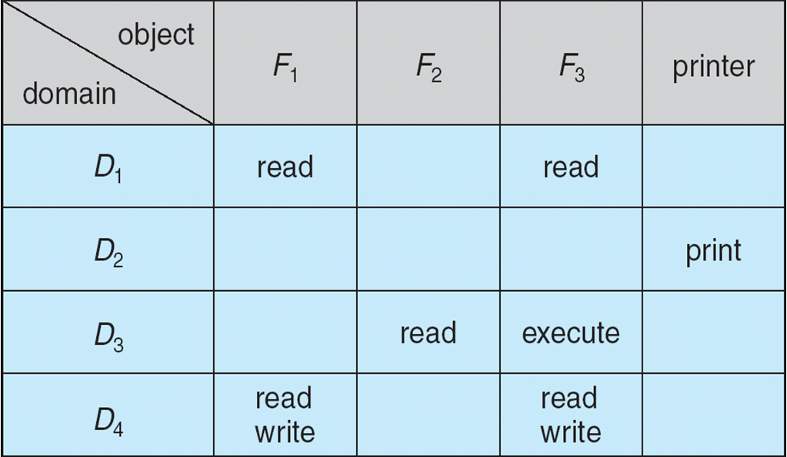
Access Matrix
View protection as a matrix (access matrix)
Rows represent domains
Columns represent objects
Access(i, j) is the set of operations that a process executing in Domain_{i} can invoke on Object_{j}
Example

Slide 15
Use of Access Matrix
If a process in Domain D_{i} tries to do “op” on object O_{j}, then “op” must be in the access matrix
User who creates object can define the access column for that object
Example

Slide 16
Access Matrix with Dynamic Protection
Operations to add, delete access rights
Special access rights:
copy – ability to copy access-rights from domain D_{i} to domain D_{j} (denoted by “*”)
owner – ability to add/remove access-rights
control – D_{i} can modify D_{j} access rights
switch – switch from domain D_{i} to D_{j}
Copy and Owner applicable to an object
Control applicable to domain object

Slide 17
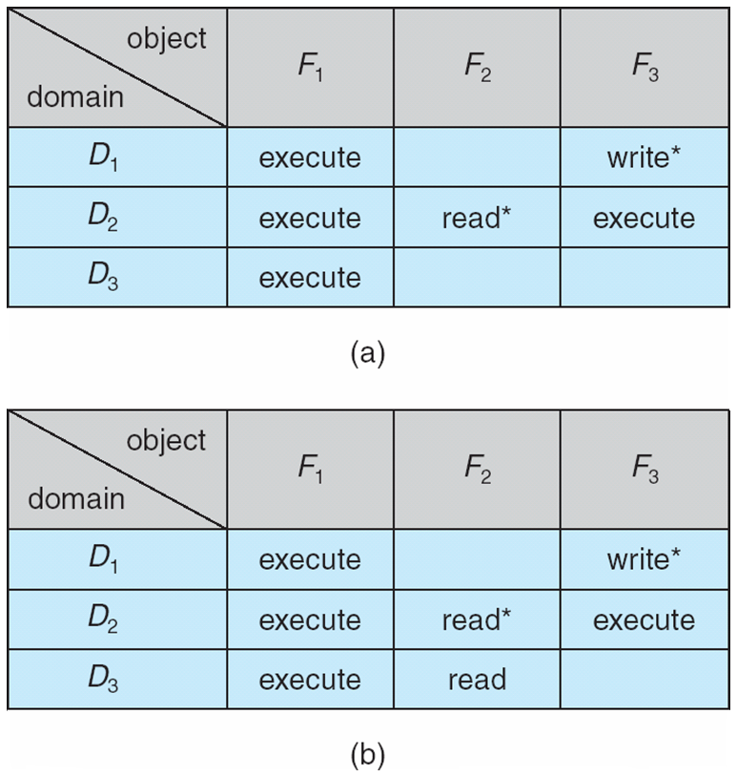
Access Matrix with Copy Rights
A process executing in Domain D₂ can copy the read access to file object F₂ to domain D₃

Slide 18
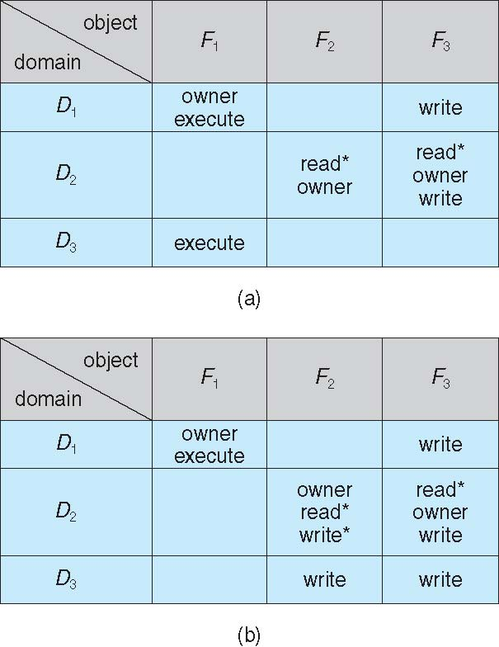
Access Matrix with owner Rights
A process executing in Domain D₂ can create the write access-right to file F₂ to domain D₂ and D₃

Slide 19
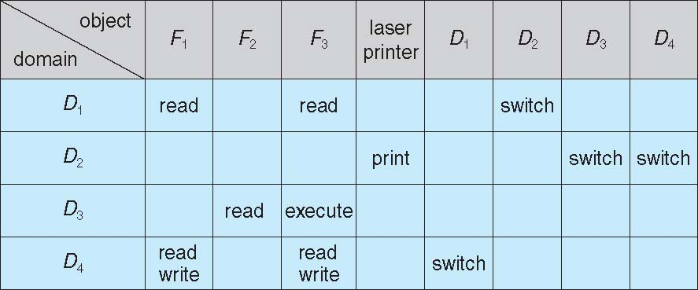
Access Matrix with Domains as Objects
A process executing in Domain D₂ can switch to domain D₃

Slide 20
Mechanism and Policy
Access matrix provides a scheme to separates mechanism from policy
Mechanism
Operating system provides access-matrix + rules
It ensures that the matrix is only manipulated by authorized agents and that rules are strictly enforced
Policy
User dictates policy
Who can access what object and in what mode

Slide 21
Implementation of Access Matrix
Generally, a sparse matrix
Option 1 – Global table
Option 2 – Access lists for objects
Option 3 – Capability list
Option 4 – Lock-key

Slide 22
Option 1: Global Table
Store ordered triples
<domain, object, rights-set>
in a global table
A requested operation M on object O_{j} within domain D_{i} ➔ search table for < D_{i}, O_{j}, R_{k} >
With M ∈ R_{k}
But table could be large ➔ will not fit in main memory
Difficult to group objects (consider an object that all domains can read)

Slide 23
Option 2: Access lists for objects
Each column implemented as an access list for one object
Resulting per-object list consists of ordered pairs
<domain, rights-set>
defining all domains with non-empty set of access
rights for the object
Easily extended to contain default set ➔ If M ∈ default set, also allow access

Slide 24
Option 2 (Cont.)
Each column = Access-control list for one object
Defines who can perform what operation Domain 1 = Read, Write Domain 2 = Read Domain 3 = Read
Each Row = Capability List (like a key)
For each domain, what operations allowed on what objects
Object F1 – Read
Object F4 – Read, Write, Execute
Object F5 – Read, Write, Delete, Copy

Slide 25
Option 3: Capability list
Instead of list being object based, list is domain based
Capability list for domain is list of objects together with operations allows on them
Object represented by its name or address, called a capability
Execute operation M on object O_{j}, process requests operation and specifies capability as parameter
Possession of capability means access is allowed
Capability list associated with domain but never directly accessible by domain
Rather, protected object, maintained by OS and accessed indirectly
Like a “secure pointer”
Idea can be extended up to applications

Slide 26
Option 4: Lock-Key
Compromise between access lists and capability lists
Each object has list of unique bit patterns, called locks
Each domain as list of unique bit patterns called keys
Process in a domain can only access object if domain has key that matches one of the locks

Slide 27
Revocation of Access Rights
Need a mechanism to allow the owner of an object to revoke access rights to that object.
Various options to remove the access right of a domain to an object
Immediate vs. delayed
Selective vs. general
Partial vs. total
Temporary vs. permanent
Revocation to:
Access list
Capability list

Slide 28
Revocation: Access List
Delete access rights from access list
Simple – search access list and remove entry
Options:
Immediate,
general or selective,
total or partial,
permanent or temporary

Slide 29
Revocation: Capability List
Need a scheme to locate a capability in the system before the capability can be revoked. Not simple since the capabilities are not directly accessible to the users.
Reacquisition – periodically delete the capability from the domain. If a user need access it must request again.
Back-pointers – set of pointers from each object to all capabilities of that object (Multics)
Indirection – capability points to global table entry which points to object – delete entry from global table, not selective.
Keys – unique bits associated with capability, generated when capability created
Master key associated with object, key matches master key for access
Revocation – create new master key
Policy decision of who can create and modify keys – object owner or others?

Slide 30
Comparison of Implementations
Many trade-offs to consider
Global table is simple, but table can be large and not fit in memory
Access lists correspond to the direct needs of users
Every access to an object must be checked
Many objects and access rights ➔ slow
Capability lists useful for localizing information for a given process
But revocation capabilities can be inefficient (more later)
Lock-key effective and flexible, keys can be passed freely from domain to domain, easy revocation

Slide 31
Comparison of Implementations (Cont.)
Most systems use combination of access lists and capabilities
First access to an object ➔ access list searched
If allowed, capability created and attached to process
Additional accesses need not be checked
After last access, capability destroyed
Consider file system with ACLs per file

Slide 32
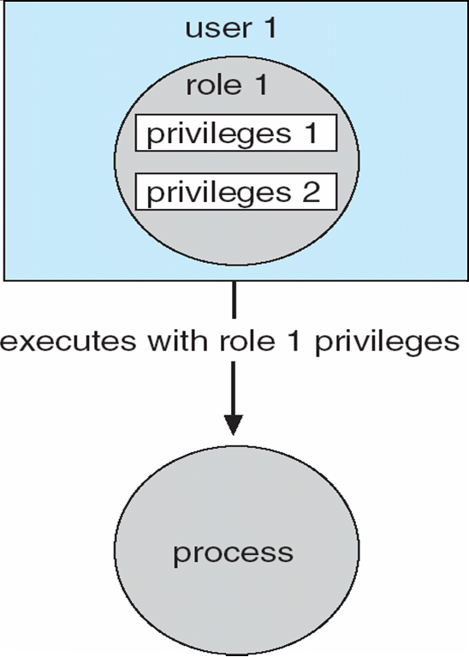
Access Control
Protection can be applied to non-file resources
Oracle Solaris 10 provides role-based access control (RBAC) to implement least privilege
Privilege is a right to execute system call or use an option within a system call
Can be assigned to processes
Users assigned roles granting access to privileges and programs
Enable role via password to gain its privileges
Similar to access matrix

Slide 33
Capability-Based Systems
Hydra. Developed in CMU in the 70s
Cambridge CAP System
Language-Based Protection

Slide 34
Hydra
Fixed set of access rights known to and interpreted by the system
For example, read, write, or execute each memory segment
User can declare other auxiliary rights and register those with protection system
Accessing process must hold capability and know name of operation
Rights amplification allowed by trustworthy procedures for a specific type
Interpretation of user-defined rights performed solely by user's program; system provides access protection for use of these rights
Operations on objects defined procedurally – procedures are objects accessed indirectly by capabilities
Solves the problem of mutually suspicious subsystems
Includes library of prewritten security routines

Slide 35
Cambridge CAP System
Simpler but powerful
Data capability - provides standard read, write, execute of individual storage segments associated with object – implemented in microcode
Software capability -interpretation left to the subsystem, through its protected procedures
Only has access to its own subsystem
Programmers must learn principles and techniques of protection

Slide 36
Language-Based Protection
Specification of protection in a programming language allows the high-level description of policies for the allocation and use of resources
Language implementation can provide software for protection enforcement when automatic hardware-supported checking is unavailable
Interpret protection specifications to generate calls on whatever protection system is provided by the hardware and the operating system

Slide 37
Protection in Java 2
Protection is handled by the Java Virtual Machine (JVM)
A class is assigned a protection domain when it is loaded by the JVM
The protection domain indicates what operations the class can (and cannot) perform
If a library method is invoked that performs a privileged operation, the stack is inspected to ensure the operation can be performed by the library
Generally, Java’s load-time and run-time checks enforce type safety
Classes effectively encapsulate and protect data and methods from other classes

Slide 38
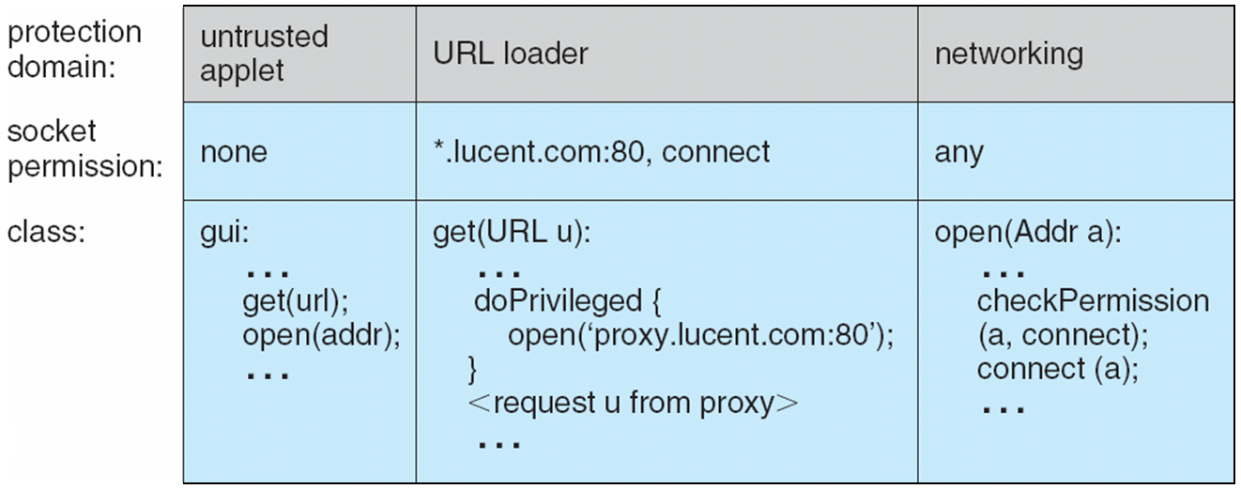
Stack Inspection

Slide 39
End of Chapter 17

Slide 40
Comparison of Implementations
Many trade-offs to consider
Global table is simple, but can be large
Access lists correspond to needs of users
Determining set of access rights for domain non-localized so difficult
Every access to an object must be checked
Many objects and access rights -> slow
Capability lists useful for localizing information for a given process
But revocation capabilities can be inefficient
Lock-key effective and flexible, keys can be passed freely from domain to domain, easy revocation

Slide 41
Access Matrix with Domains as Objects

Slide 42
Use of Access Matrix
Can be expanded to dynamic protection
Operations to add, delete access rights
Special access rights:
owner of O_{i}
copy op from O_{i} to O_{j} (denoted by “*”)
control – D_{i} can modify D_{j} access rights
transfer – switch from domain D_{i} to D_{j}
Copy and Owner applicable to an object
Control applicable to domain object

